Slide 1
The PSP Association
Presented by: Kathy Weston
Specialist Care Advisor
Working for a world free of PSP
Registered charity numbers: England and Wales 1037087 / Scotland SC041199
Notes:
Category one:
Slide 1:
Add title of talk and presenters name

Slide 2
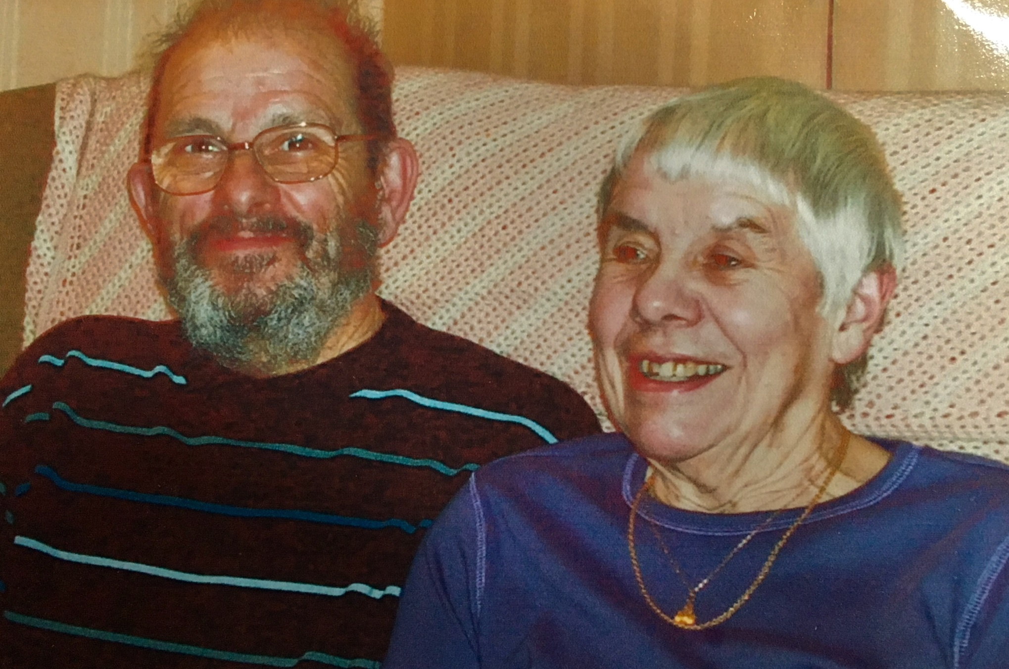

Slide 3
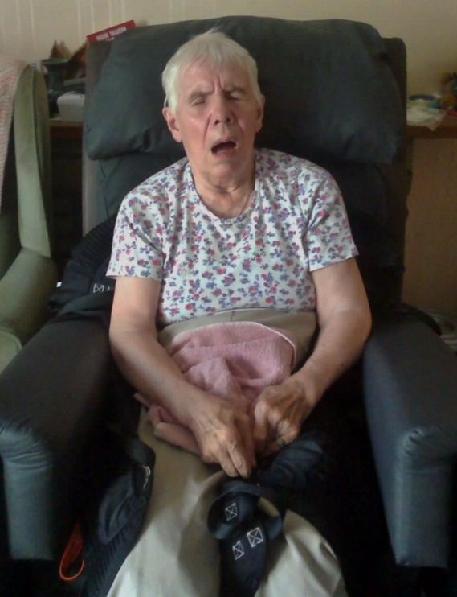

Slide 4
What We Offer:
Specialist
Care Adviser
Helpline and information advisory service
Website/
PSP Matters
E-newsletter
Local Groups
Research
Education
Health
Unlocked
Person with PSP or CBD & their carer
Notes:
Category one:
Slide 3:

Slide 5
Specialist Care Advisers
Six to cover whole of UK
Regular proactive contact with all people known to us with PSP/CBD
Signposting to relevant statutory and voluntary agencies
Recording gaps in service and areas of good practice
Dealing with complex cases referred from the Helpline
Education
Support at some specialist clinics
Identifying and developing relationships with key HSCPs
Closely working with other staff to develop and promote existing and new initiatives
Notes:
Category one:
Slide 5:

Slide 6
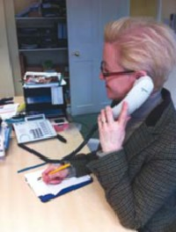
Helpline and Information Advisory Service
Advice
Information
Practical and emotional support
“I contacted the Helpline today for the first time. It is a marvelous service. They understood my situation and were so helpful.”
Information sheets and publications
Educational events / Family and Friends Days
Notes:
Category one:
Slide 14:

Slide 7
Symptoms of PSP
Falls - often backwards
Postural Instability
Eye Problems
Swallow Problems
Speech Problems
Cognitive Changes
Bladder and Bowel
Pain
Notes:
Category two:
Slide 3:
Progressive symptoms of rigidity, slowness of movement, slowness of eye movement, loss of balance with early falls, problems with speech and swallow, cognitive changes.
.

Slide 8
Key Features of PSP
Little or no response to Levodopa
No presenting tremor
Rarely affects people under 40
Steady deterioration
Restricted eye movement
Neurofibrillary tangles not Lewy Bodies
Notes:
Category two:
Slide 4:

Slide 9
What is CBD?
Cortico – affecting the brain cortex
Basal – also affecting other parts of the brain such as the basal ganglia
Degeneration – death of nerve cells in the brain
Notes:
Category two:
Slide 5:

Slide 10
What is CBD?
Cortico Basal Degeneration
Numbness, jerking fingers, loss of use of one hand
Asymmetric; progressively affecting arm and leg
Alien limb
Less common disturbance of eye movement
Increased frontal lobe deficit
Notes:
Category two:
Slide 6:
CBD is similar to PSP but the main symptoms are (read from slide)
Asymmetric - Not occurring equally on both sides of the body.
Lobe – large portion of
frontal lobe the rostral (anterior) portion of the cerebral hemisphere

Slide 11
How is PSP diagnosed
Historically the only reliable form of diagnosis was post-mortem
Diagnosis was usually given based on the clinical presentation and often delivered as “probable PSP”
Notes:
Category two:
Slide 10: (Slide 1 of 3 in series):

Slide 13
Who is Eligible for NHS Continuing Healthcare?
NHS Continuing Healthcare is only available to those who meet specific eligibility criteria and are considered to have a ‘primary health need’. Not everyone with a long term condition will be eligible as assessment is based on the nature, complexity, unpredictability and intensity of identified health care needs.
Notes:
Category Twelve:
Slide 2:

Slide 14
Behaviour (CHC)
Frequently there is motor recklessness and impulsivity with lack of insight into risks
There may be fixed and rigid thinking making co-operation with aspects of care difficult
Challenging behaviour and/or mood changes may exist (e.g. aggression, frustration, depression) – requiring specialist advice
Notes:
Category Twelve:
Slide 7: (Slide 2 of 14 in CHC series):

Slide 15
Cognition (CHC)
Executive functioning skills tend to be affected – slowness of thought, difficulty with recall, disorientation and memory loss. May be unable to follow instructions/respond appropriately
Capacity to make decisions is often impaired or lost – a high level of communication skill required of carers
Notes:
Category Twelve:
Slide 8 (Slide 3 of 14 in CHC series):

Slide 16
Psychological/Emotional (CHC)
Anxiety, depression and/or agitation may require specialist advice to support and manage
Difficulties in sleeping/staying asleep with very disturbed nights
Constant fatigue
Emotional lability - behaviours may be inappropriate to the situation
Notes:
Category Twelve:
Slide 9: (Slide 4 of 14 in CHC series):

Slide 17
Communication (CHC)
Speech may be very quiet and slurred or ability to speak at all may be lost
Ability to process information may be severely impaired and yes/no responses to questions confused (even when using signs)
Eye movements are often restricted so may be unable to use visual aids
Ongoing SALT assessment/review required
Notes:
Category Twelve:
Slide 10 (Slide 5 of 14 in CHC series):

Slide 18
Mobility (CHC)
Motor recklessness and impulsivity often lead to a very high risk of falls (head injuries/fractures) so constant supervision is required and physiotherapy/OT review
Restricted vision often negatively impacts on the situation with failure to see hazards
May be unable to walk, have severe rigidity in muscles and/or be confined to bed
Notes:
Category Twelve:
Slide 11: (Slide 6 of 14 in CHC series):

Slide 19
Nutrition (CHC)
The ability to swallow can be lost leading to high risk of aspiration not just on foods but on saliva even if Nil by mouth
May require assistance with feeding due to physical limitation of movement and high risk of aspirating – PEG may be discussed/fitted
Ongoing assessment/review by the SALT and dietitian is essential
Notes:
Category Twelve:
Slide 12 (Slide 7 of 14 in CHC series):

Slide 20
Continence (CHC)
Incontinence may need managing. Support from a continence adviser may be required – management plan will need to consider an individuals cognitive abilities when deciding style of management
Constipation management is often an issue
Frequent UTI’s – sometimes without signs of infection
Notes:
Category Twelve:
Slide 13: (Slide 8 of 14 in CHC series):

Slide 21
Skin Integrity (CHC)
Skin requires regular checking through the day, especially if unable to move limbs independently or walk
Individual may not use pressure relieving products despite encouragement to do so
Repetitive actions can lead to skin breakdown
Hand contractures leading to difficulty maintaining hygiene
Notes:
Category Twelve:
Slide 14: (Slide 9 of 14 in CHC series):

Slide 22
Breathing (CHC)
There can be a high risk of chest infections due to aspirating on food/drinks/saliva
Referral to a respiratory specialist may be required
Input from a physiotherapist to advise on chest physiotherapy may be required
Notes:
Category Twelve:
Slide 15: (Slide 10 of 14 in CHC series):

Slide 23
Medication (CHC)
Medication may need to be managed by skilled carers who can administer the prescribed daily medications and who can ascertain requirement to use other medications (eg for anxiety, agitation, pain etc)
Notes:
Category Twelve:
Slide 16: (Slide 11 of 14 in CHC series):

Slide 24
Altered states of consciousness (CHC)
Dependent upon stage of the condition
Significantly reduced blink rate and involuntary eye closure can make it appear that someone is asleep when they are not
Notes:
Category Twelve:
Slide 17: (Slide 12 of 14 in CHC series):

Slide 25
Other Significant Care Needs (CHC)
May include management of fatigue, pain and co-existing conditions
Cognitive issues can affect any of the 12 domains, making care more complex
Notes:
Category Twelve:
Slide 18: (Slide 13 of 14 in CHC series):

Slide 26
Overall Considerations (CHC)
PSP is a progressive condition - the course of the condition can be very unpredictable
Constant supervision and/or support may be required 24 hours a day
A high level of MDT input and co-ordination from a keyworker is required
Palliative care services usually have a key role from an early stage
Notes:
Category Twelve:
Slide 19: (Slide 14 of 14 in CHC series):

Slide 27
What Does Quality Care Look Like?
Holistic approach
Right care and support in the right place at the right time
Being understood and supported by people who know about the conditions, so that appropriate and timely referrals can be made when needs change
Access to timely, accurate and relevant information to enable independence and make informed choices
Notes:
Category Thirteen:
Slide 1:
The Pathway of Care for PSP is our core information to support you in your role. It sets out the standards of care and the intervention required from HSCP’s across a number of disciplines. Please use your publication list to request more copies of this and our other information for HSCP’s i.e. our guide to cognition and guide for OT’s.

Slide 28
Palliative Care
Improving with awareness of neurological illness
Focus on quality of life
Potential for rapid deterioration – proactive monitoring and symptom management
Include on GP palliative care registers / Gold Standards Framework (GSF)
Referral to specialist palliative care
Need for multi-disciplinary / multi agency care
Preferred Priorities of Care – Advance care planning
Advanced Decisions – Mental Capacity
Continuing Care Assessment
Hospice, respite care, outreach team
Carer support
Notes:
Category Thirteen:
Slide 11:
The National Gold Standards Framework (GSF) Centre in End of Life Care is the national training and coordinating centre for all GSF programmes, enabling generalist frontline staff to provide a gold standard of care for people nearing the end of life.
Advance Care Planning (ACP) is a key part of quality provision of end of life care. Improving the pre-planning of care has been found to be one of the most important ways that we can ensure reliable patient-focused care. It is anticipated that it will be an important key part of the new NHS End of Life Care Strategy.

Slide 29
A Carers View
“This disease just takes and takes and then
takes again. Is there nothing that it will leave
us, so we can have a tiny bit of normality…”
(Anon – Health Unlocked 2014)
Notes:
Category Fourteen:
Slide 4:

Slide 30
A Carers View
“Sometimes I wonder what will happen if I just can’t do this anymore. And I know that is not an option. But the thing is I love him and sometimes I see him again, just for a moment, before he turns back into this person he has become – it breaks my heart…I am very, very tired and sad.”
(Jill - Health Unlocked 4 Dec 2014)
Notes:
Category Fourteen:
Slide 6:

Slide 31
Further Reading
https://www.youtube.com/watch?v=VVWGutY0xbw
https://www.youtube.com/watch?v=uU2cLUlhN2s
Dudley Moore: An Intimate Portrait by Rena Fruchter
Last Dance at the Savoy: Life, Love and Caring for Someone with Progressive Supranuclear Palsy by Kathryn Leigh Scott and Dr. Yvette Bordelon
You, me and PSP by Steve Dagnell – available exclusively from PSPA
Notes:
Category one:
Slide 7:

Slide 32
For more information
Please look at our website: www.pspassociation.org.uk
or Telephone: 0300 0110 122
or Email: helpline@pspassociation.org.uk
or Write to us at: The PSP Association
PSP House
167 Watling Street West
Towcester
Northamptonshire
NN12 6BX
Notes:
Category one:
Slide 19:

